Slide 1

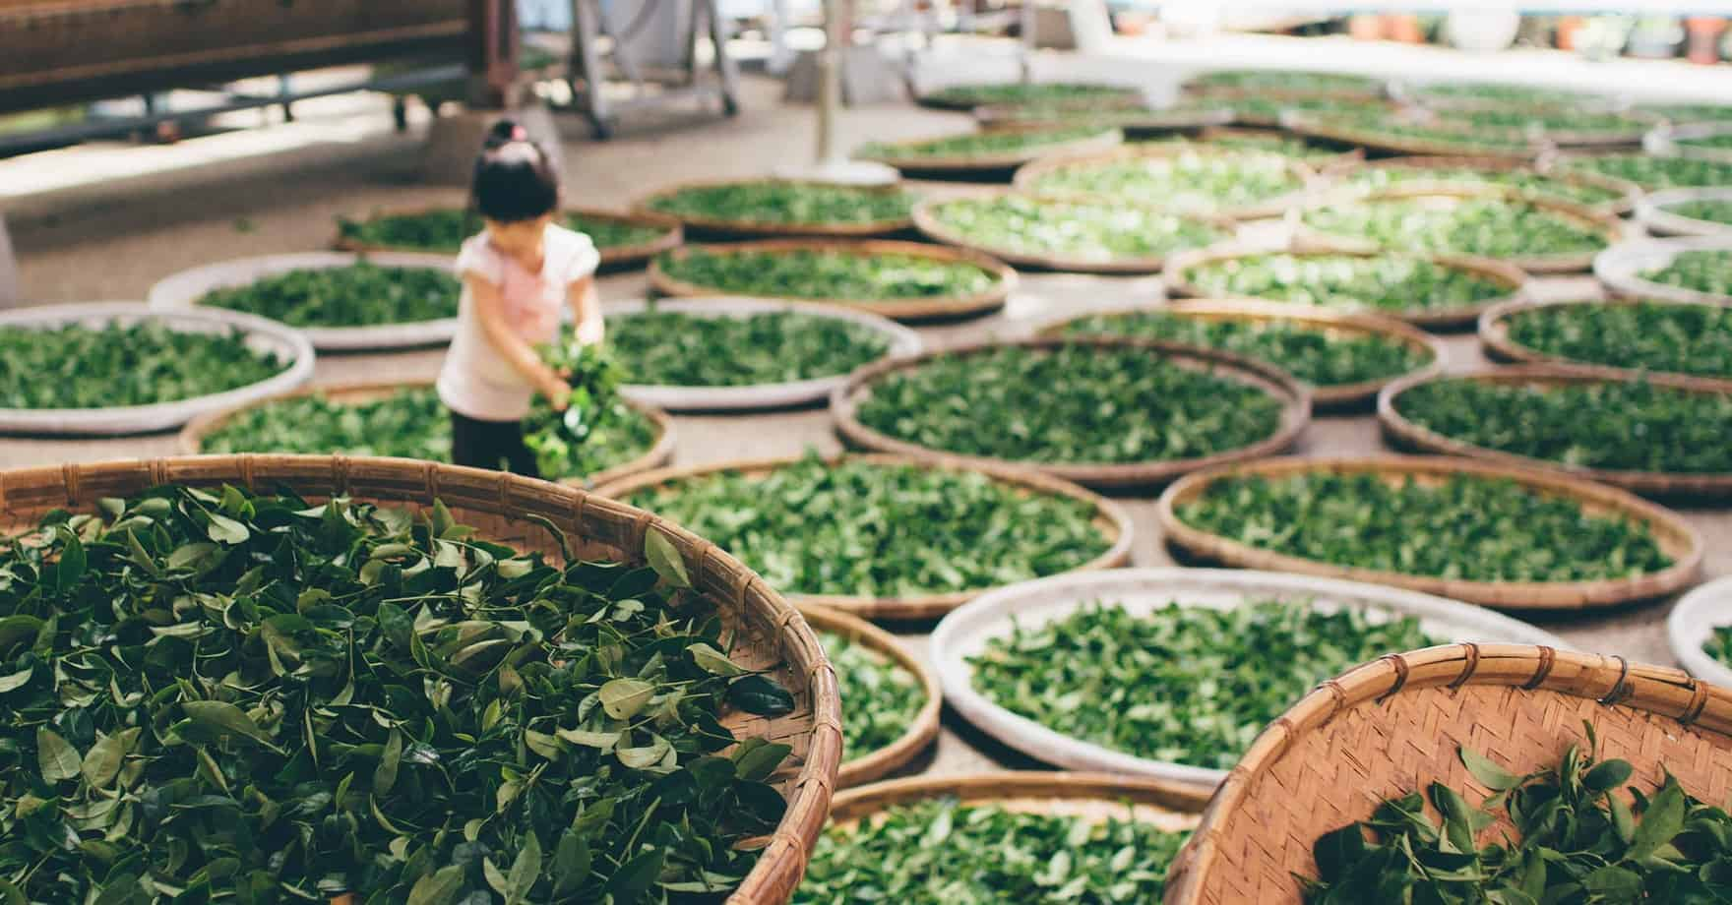
TEA MARKET
By Niharika Chahar

Slide 2


BRIEF OVERVIEW
Modern tea comes from Camellia sinensis, a tree native to China and India. In today’s commercial tea trade, there are three main varieties of Camellia sinensis: China, Assam (northeastern India), and Cambodia, each named for the area in which it was first grown commercially. The China variety is a hardy, 3-meter-high bush with a useful lifespan of one hundred years. The Assam and Cambodia varieties are tall single-stem trees with a commercial life of forty years. Typically, tea trees are kept short through frequent trimming for easy plucking (i.e., the picking of tea leaves). Although tea can be grown in a variety of agro climatic conditions, the best teas are grown at altitudes between 1,000 and 2,000 meters.

Slide 3
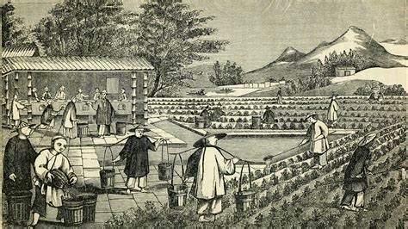
Green Tea
Green tea has a less processed flavor than black tea. The leaves are steamed and heated immediately after plucking. Because the leaves are dried without going through fermentation, they remain green. After being separated by grade, the leaves are packed in chests lined with aluminum foil. Green tea, which accounts for a quarter of global tea output, is supplied primarily by China and to a lesser degree by Japan, Vietnam, and Indonesia.
Oolong tea is traditionally prepared in South China and Taiwan from a special form of the China tea plant— the chesima. It has large leaves and a distinct flavor. Preparation is similar to black tea but with a much shorter fermentation process. Oolong teas, which account for only a small fraction of the global market, are often scented with flowers.

Slide 4
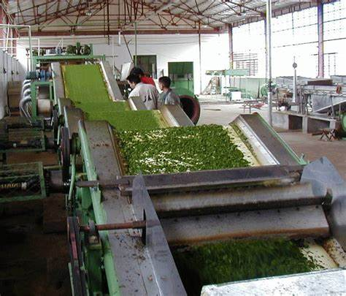
Production and TARDE
Tea is produced in both tropical and temperate zones. Because it grows at high altitudes, it typically does not compete with food or other cash crops. Asia accounts for about three-quarters of global production, Africa for half the remainder, and several Middle Eastern and Latin American countries for the rest. During 2002–2005 China and India produced more than half of the world’s tea (26 and 27 percent, respectively), followed by Sri Lanka (10 percent) and Kenya (9 percent). Global tea production during this period was 3.25 million tons.
Tea is produced by both smallholders and estates. Tea estates are owned by large companies producing large quantities of tea, normally exceeding 1,000 tons of made tea (sometimes as much as 10,000 tons). Tea estates employ both permanent and seasonal laborers. Often, the permanent laborers reside in living quarters within the estate and receive other benefits, such as basic health care and schooling for their children.

Slide 5

Global tea production from 2000 to 2004 exceeded three million tons, valued between $4 and $5 billion annually. Growth in tea production, as high as 4 percent in the 1970s and 3 percent in the 1980s, slowed to 1.6 percent in the 1990s. Almost half of global tea production is traded internationally. Sri Lanka (22 percent), China (18 percent), Kenya (16 percent), and India (16 percent) account for almost three-quarters of world exports. The United Kingdom used to be the largest tea importer (during the 1960s it accounted for almost 40 percent of world imports, but by the early 2000s it accounted for only about 10 percent). The dominant tea importer is Russia, which accounted for 12 percent of world imports in 2005.

Slide 6
PROCESS FLOW OF THE INDUSTRY
1
2
3
PLUCKING is the process of harvesting of tea leaves.
PLANNING
COOLING

Slide 7
4
5
6
ROLL BREAKING
DRYING
SHIFTING and SORTING
7
8
9
STEAMING and COOLING
ROLLING
DRYING

Slide 8
4
5
6
FINAL ROASTING
ARACHA
FINAL PRODUCT – ARACHA, ALSO KNOWN AS CRUDE TEA

Slide 9
TOP 5 PLAYERS OF THE TEA INDUSTRY BY REVENUE
JDE PEET’S NV
TATA CONSUMER PRODUCTS LIMITED
BOMBAY BURMAH TRADE CORPORATION
CCL PRODUCTS INDIA
ITO EN

Slide 10
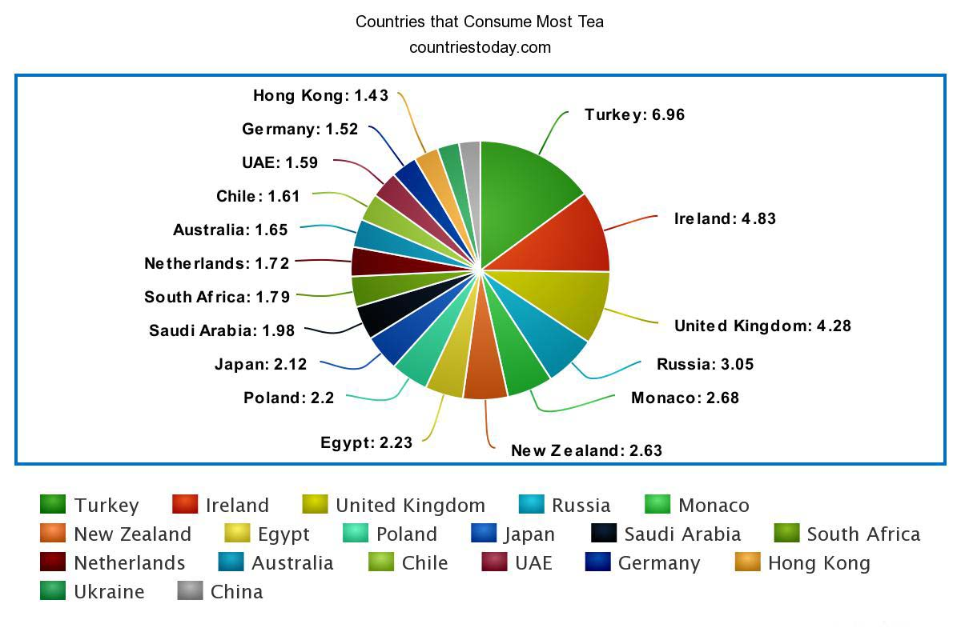
TEA CONSUMPTION

Slide 11
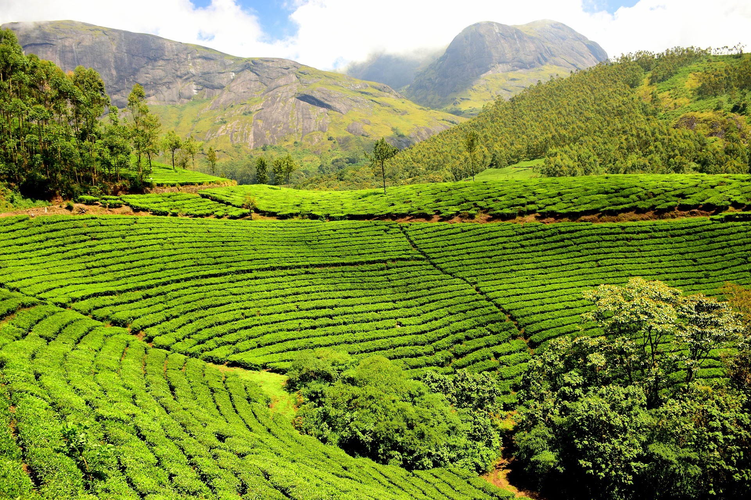
BIBLIOGRAPHY
Google websites
Research analysis of experts
Global and Domestic news

Slide 12
INDUSTRY EXPERTS
1. Peter F. Goggi, President, Tea Association of the U.S.A., Inc.
2. Sharyn Johnston, CEO, Australian Tea Masters
3.Shamol Ghoshal, Tea Consultants India
4. Linda Barberic, Tea Designer, Soma Tea Inc
5. Bala Sarda, CEO, Vahdam tea, India.

Slide 13
EMAIL
Dear Expert,
My name is Niharika Chahar and I work for Infollion Research Services providing companies with on-demand expert services via various sources.
Recently one of our clients got in touch with you for particular guidance of yours but due to some unforeseen misunderstandings, the meeting didn’t go well. First of all, I apologize for the inconvenience you faced. As all our clients and experts are of great value to us and as a company, we focus on the efficiency and effectiveness of the experts towards our clients I want you to kindly focus on the guidance you will be providing as it will be of great value to you as an expert in this industry.
Secondly talking about payment we as a company always focus on up-to-level remuneration and the benefit of all the people associated with us. So kindly look towards the positive outcome and have faith in us as we are here for your welfare only. Rest assured that all outstanding items will be completed. We will do so using the same high standards as we apply to all of our projects.
Hope to hear something great from you soon.
Regards, Niharika Chahar Infollion Research Services.

